Slide 1
Shipment Monitoring
ES – IOT Presentation
Done by:
Shivani Shinde 3474
Asmita Walunj 3487

Slide 2
What is shipment monitoring technology?
It is a technology which tracks the cargo i.e. a package, from the place it is shipped to it’s destination.
This technology allow manufactures and shippers to track shipments and prevent theft in previously impossible way.

Slide 3
Example:
Original Station
Area collected from within original station
VLP
Area to be delivered
Building name
Floor number
E
3
9EX12
Destination railway station
Mumbai Dabbawalas

Slide 4
IOT in Shipment Monitoring
The IOT utilises RFID (Radio Frequency Identification), composed of a chip, reader and database along with cloud-based GPS system.
These chips can communicate with each other with combination of RFID and IOT.

Slide 5

Product based on Real Time Shipment

Slide 6
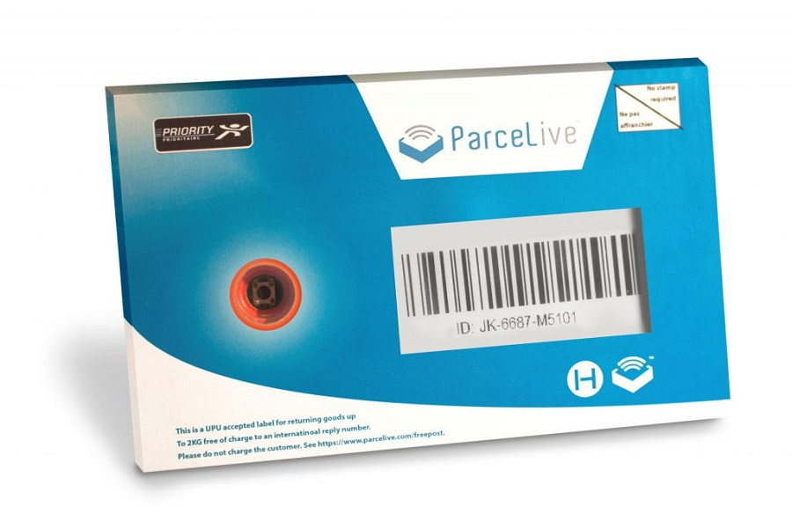
Step 1:Barcode Scanned

Slide 7

Step 2: Device Inserted

Slide 8
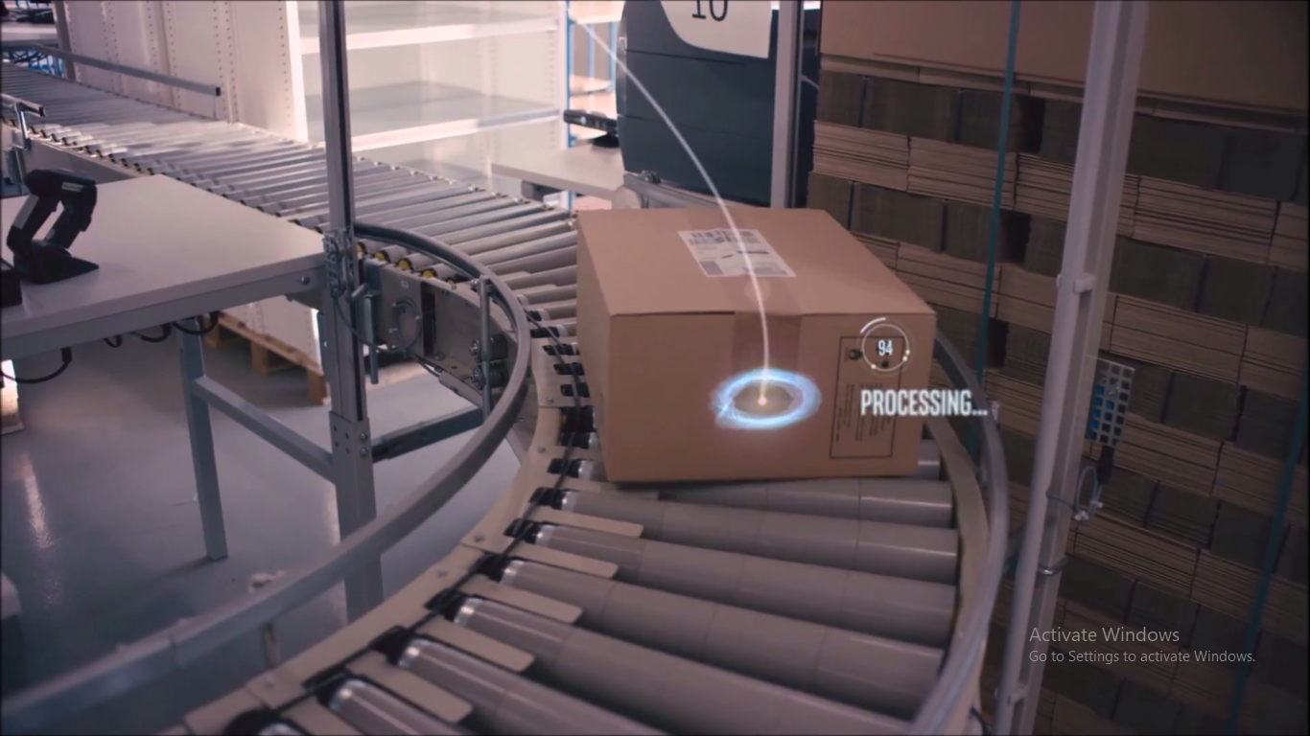
Step 3: Parcel is Live

Slide 9

Step 4: Push Button to end Live Tracking

Slide 10
Thank You!

